Slide 1
Main Figures

Slide 2
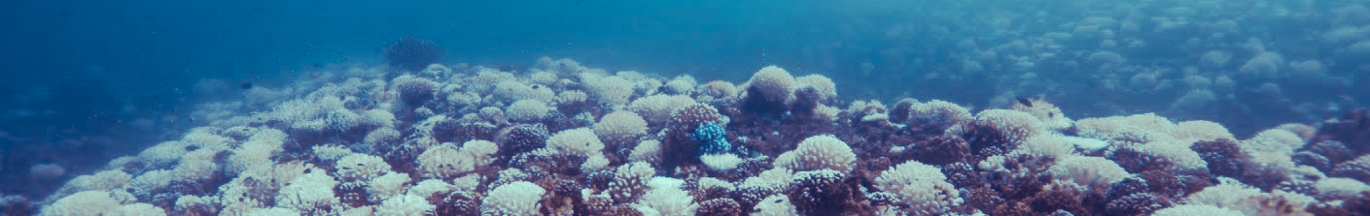
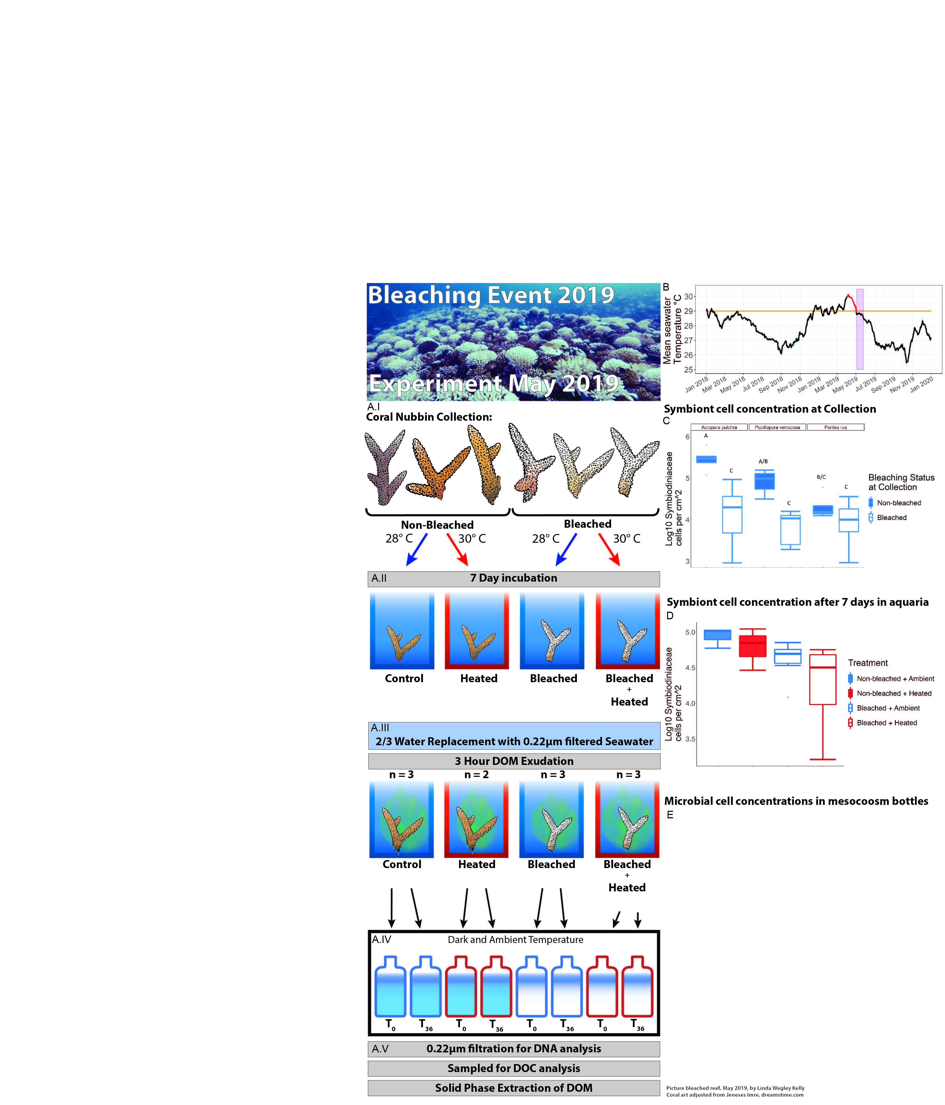
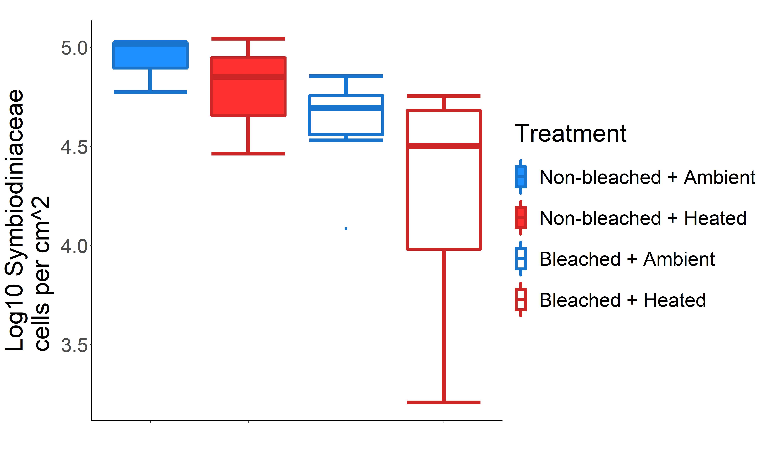
Bleaching Event
Experiment May 2019
Figure 1: Experimental design and justification. Non-bleached and bleached corals were collected from a reef in Mo’orea, French Polynesia immediately following a bleaching event. A) Picture of the LTER1 fore reef in Mo’orea, French Polynesia representative of the status of the reef where both bleached and non-bleached corals were present. A.I-A.V) depict the experimental design and sampling from corl nubbin collection (A.I), 7 day pretreatment in flow through aquaria (A.II), DOM exudation (A.III), 36 hour dark bottle incubation (A.IV), and sampling (A.V). B) Mean seawater temperatures over the period from January 1st 2018 until December 31st 2019 from 3 fore reef LTER sites. The Mo'orea Coral Reef Long Term Ecological Research (MCR LTER) daily average water temperature data time series was combined from 3 sites on the MCR LTER fore reef: FOR1, FOR4 and FOR5 (GPS location: 17°28'30.0"S 149°50'13.2"W; 17°32'49.2"S 149°46'08.4"W; 17°34'55.2"S 149°52'30.0"W; respectively). From each location data from five sensors (“upper water column”, “middle water column”, “bottom water column”, “temperature shallow”, and “temperature deeper”) was used to calculate the average temperature +/- 1 standard deviation. Standard deviation depicted in blue. The orange line indicates the thermal stress accumulation threshold level of 29°C. Bleaching was first observed in April 2019, indicated by the start of the red line, which continued until the temperature levels dropped under the thermal stress accumulation threshold. The experiment, indicated by the purple block, was started immediately after temperatures dipped below the thermal stress accumulation threshold. C) Symbiont cell concentrations of a subset of collected nubbins who were sacrificed after the three day acclimatization period to validate the observed bleaching status at collection. Healthy corals had significantly higher symbiont levels compared to bleached corals (two-way ANOVA, F=45.552, p=2.67e-08). D) Symbiont cell concentrations of the nubbins after 7 days in the aquaria and immediatly after DOM exudation. The 4 coral treatments had varying degrees of bleaching/paling with healthy at ambient temperatures having the highest concentrations, although these differences were not statistically significant (one-way ANOVA, F=2.623, p=0.123).

Slide 3
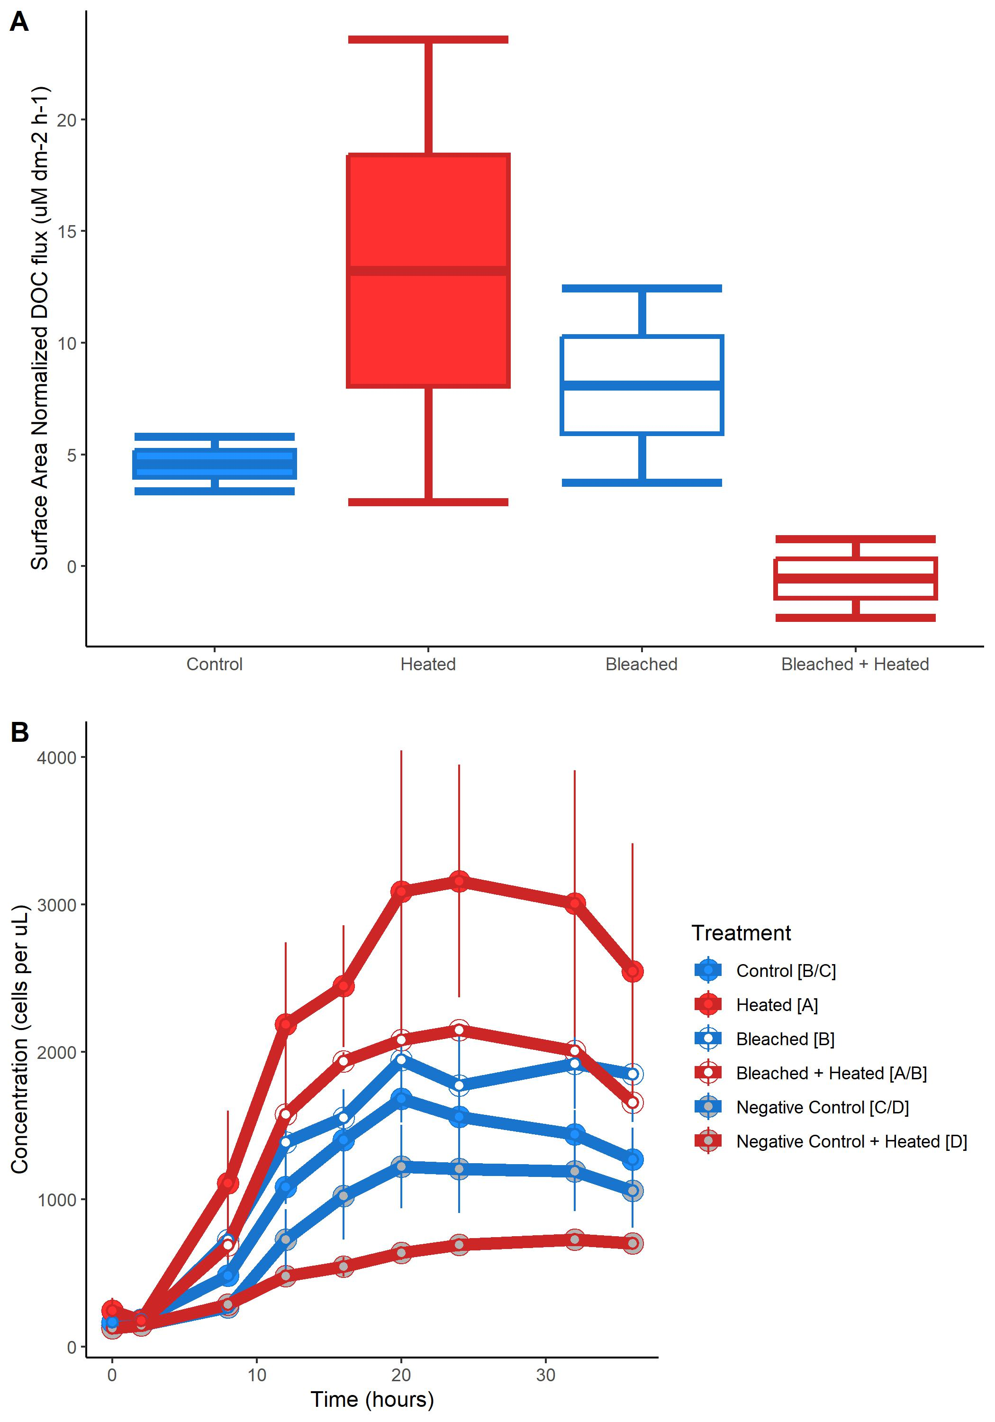
A
B
Figure 2: released DOC and microbial growth. A) Box and whisker plots of surface area normalized DOC concentrations for the 4 coral treatments. B) Bacterial growth curves for the 6 treatments in the 36 hour bottle incubation, error bars indicate standard error of the mean. Significant differences between treatments (Tukey post-hoc test, p<0.05) are denoted by the square brackets after each treatment name in the legend.

Slide 4
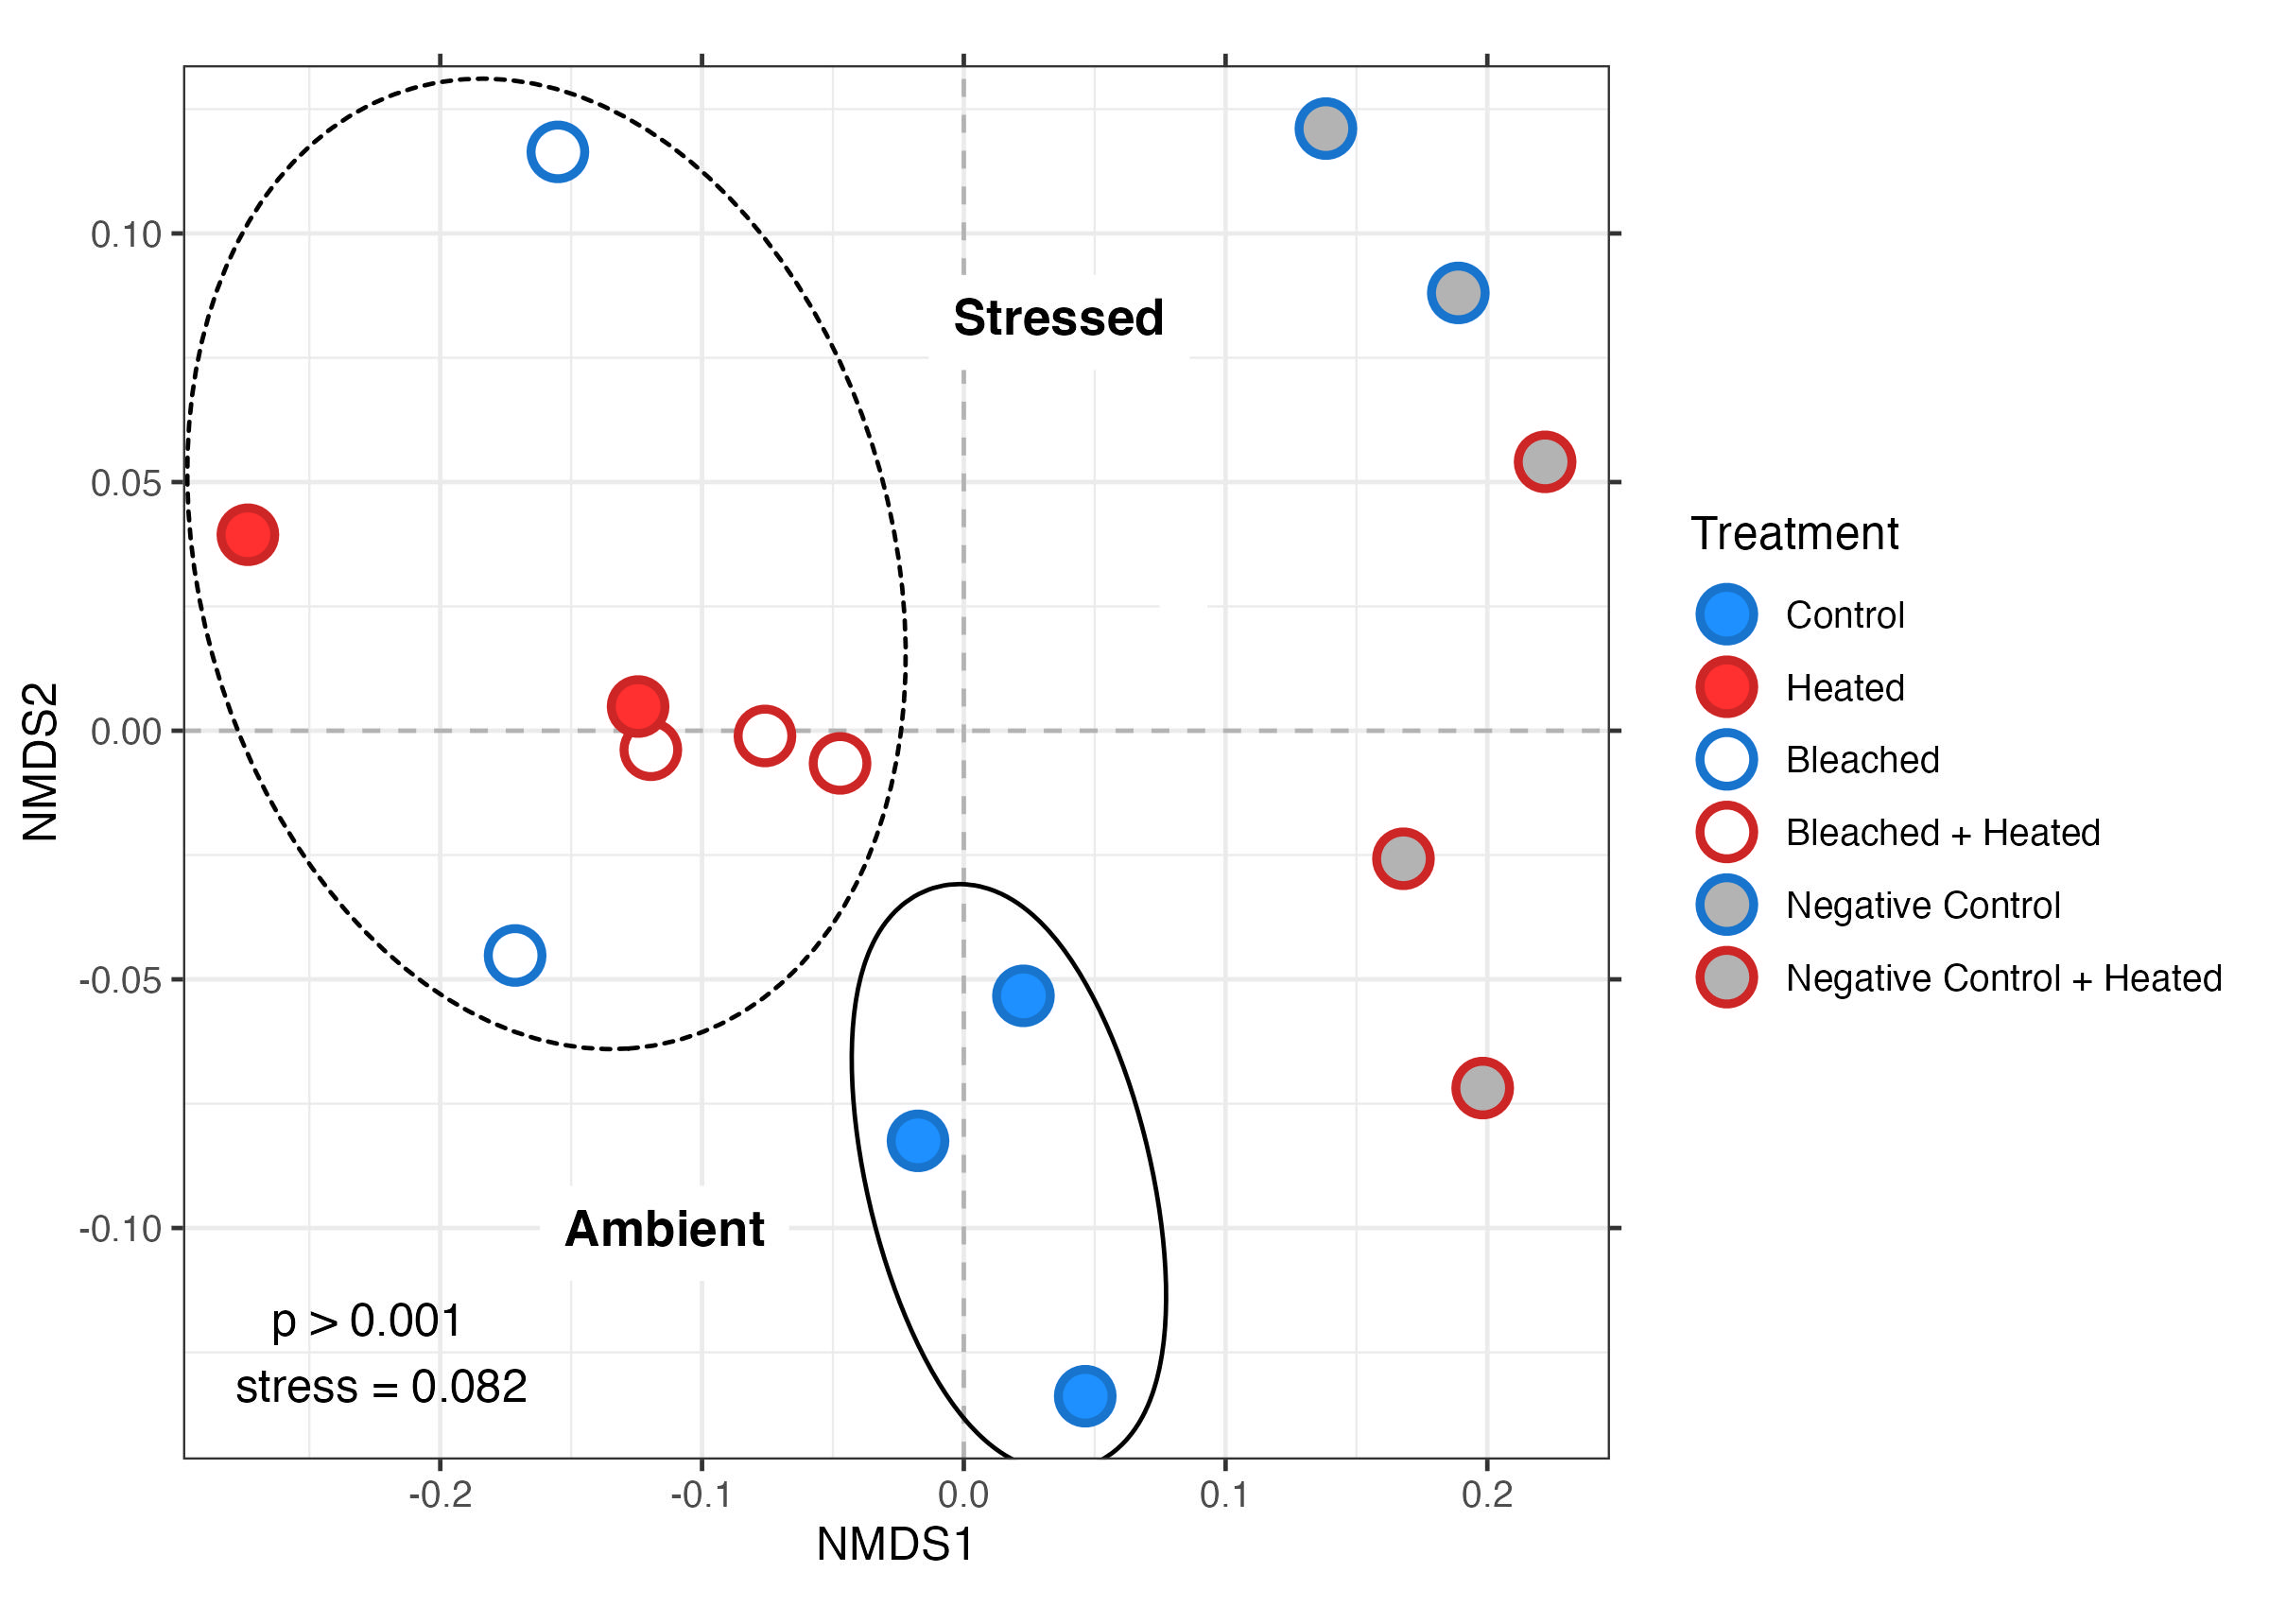
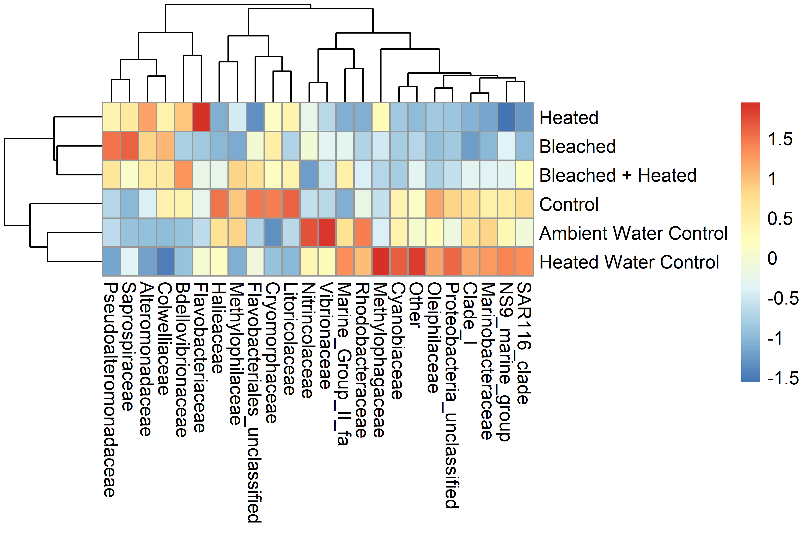
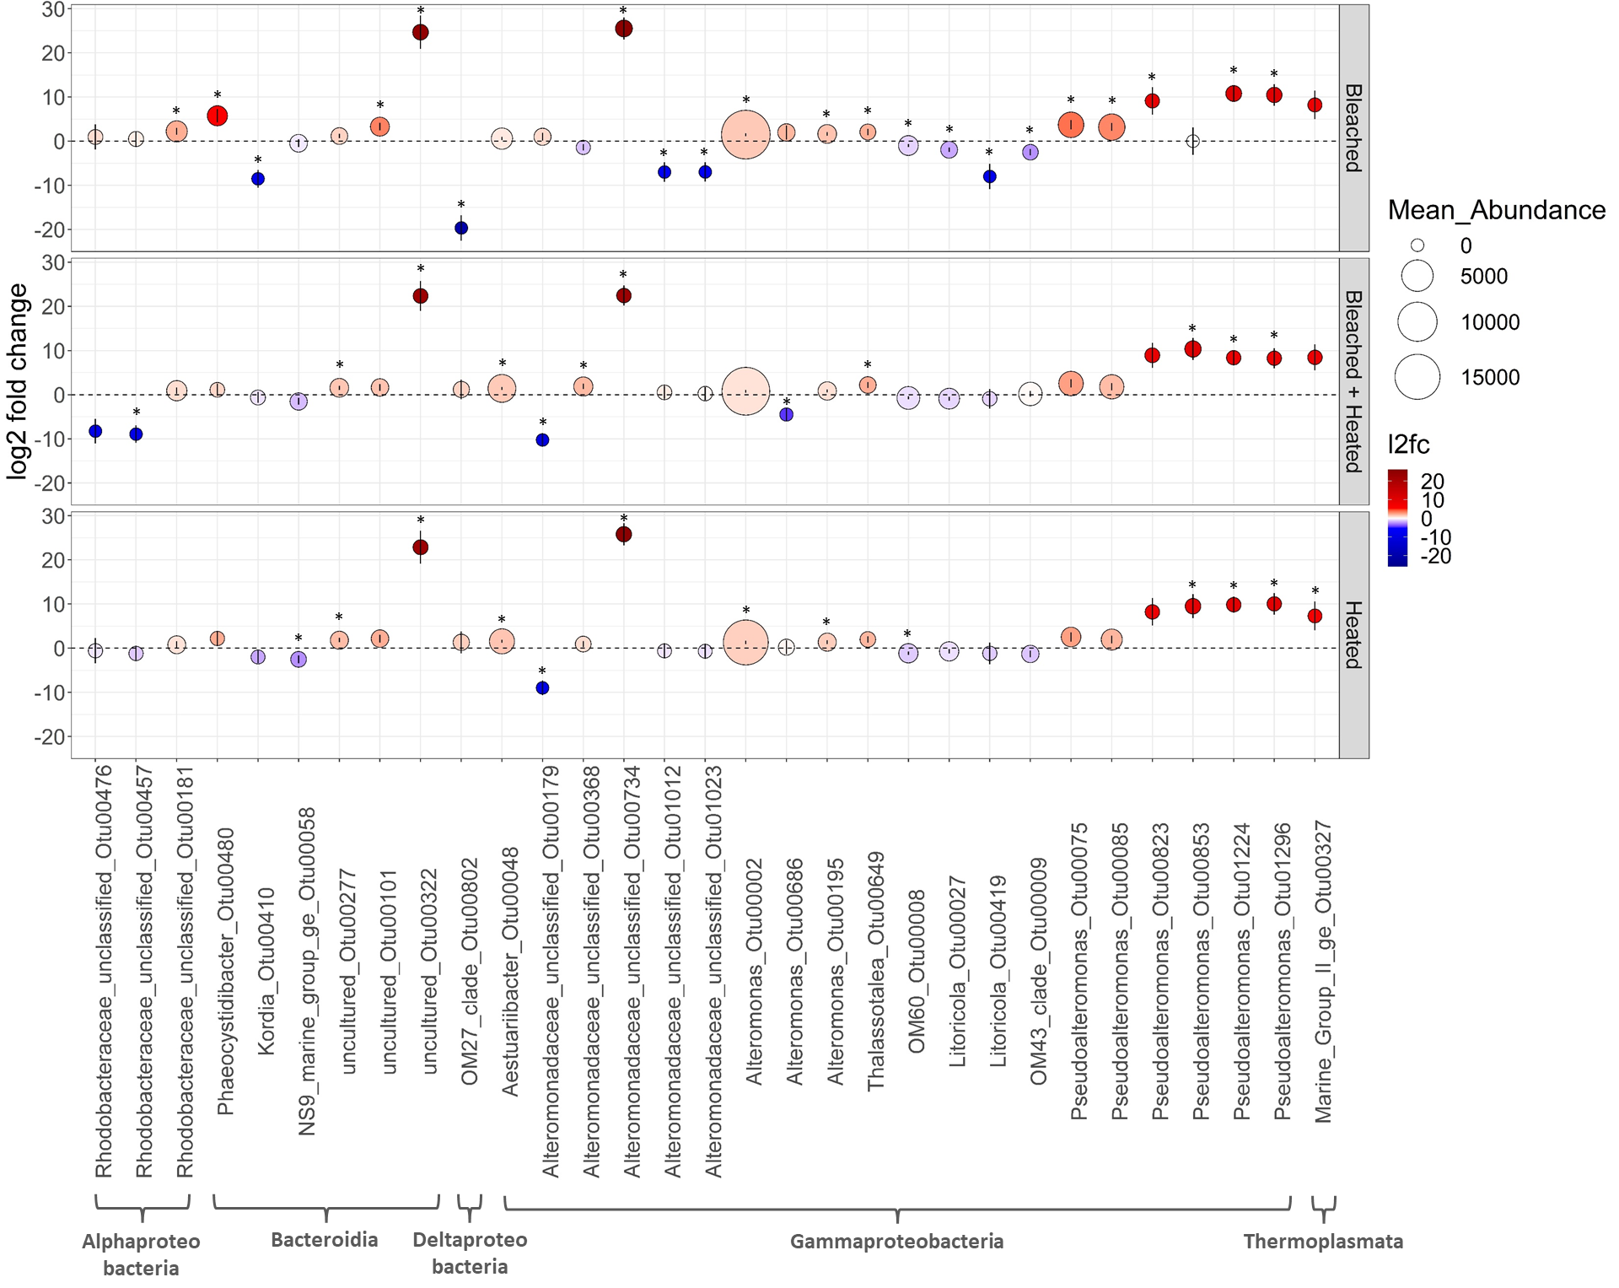
A
B
Z-score
C
Figure 3: Microbial community composition. A) Non-metric multidimensional scaling of microbial community samples using Unifrac distances derived from 16S amplicon data. A dashed ellipse denotes the 3 coral stress treatments while a solid ellipse denotes the ambient coral Control treatment. B) Two-way heatmap of the most abundant bacterial Families in each treatment. Abundant families were defined as: relative abundance ≥ .005 in samples ≥ 3 or a relative abundance ≥ .1 in samples ≥ 1. Each cell represents the z-scored mean relative abundance of a given Family in a treatment. Cells are colored according to z-score, with warmer colors indicating enrichment and cooler colors indicating depletion. Clustering was performed using Euclidian distances. C) Visualization of the 31 OTUs determined to be significantly differentialy abudant (DA) compared to Control samples by DESEq2. Dotplot of the log2 fold-change values for the 31 significantly DA OTUs in the 3 coral stress treatments. Each dot represents a given OTU in a given treatment. Dot height on the y-axis and color correspond to l2fc values. Error bars depict the standard error of each l2fc value calculated by DESEq2. Dot size corresponds to mean raw abundance. Each OTU is labeled according to it’s Class, Family, and Genus_OTUNumber on the x axis. Astrices denote a significantly DA ASV in a given treatment.

Slide 5
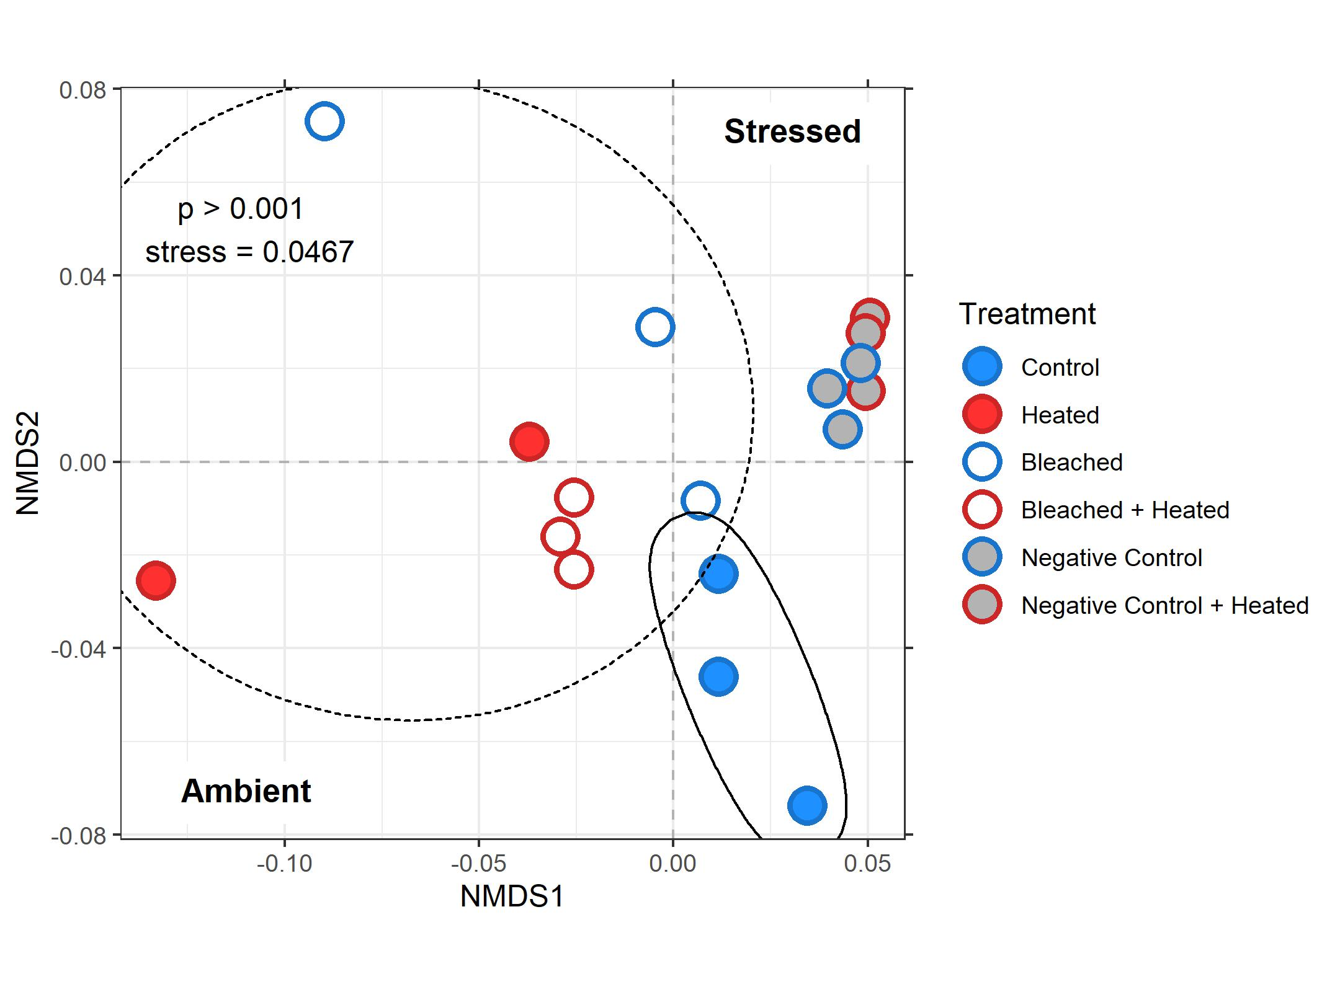
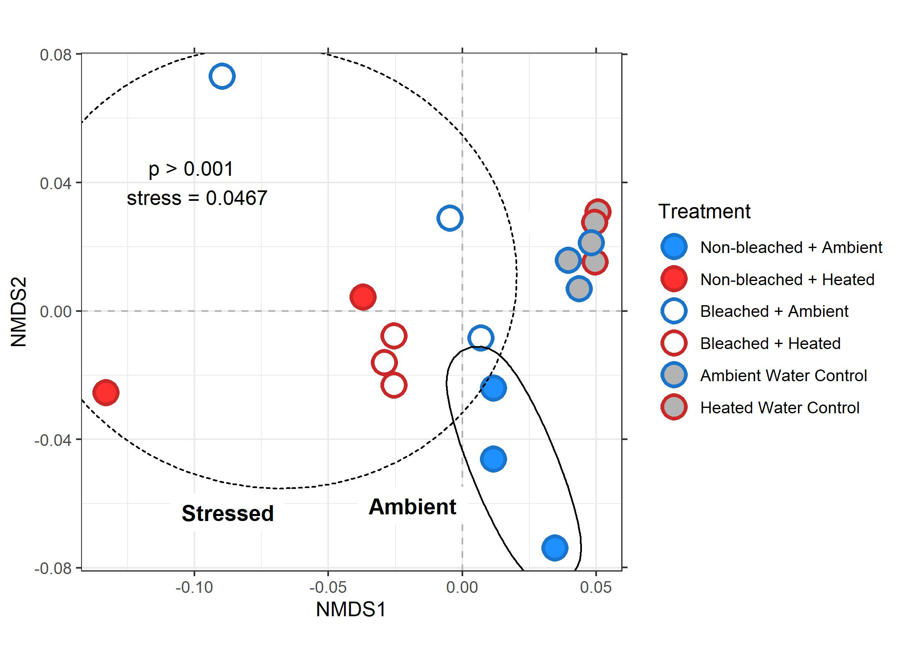
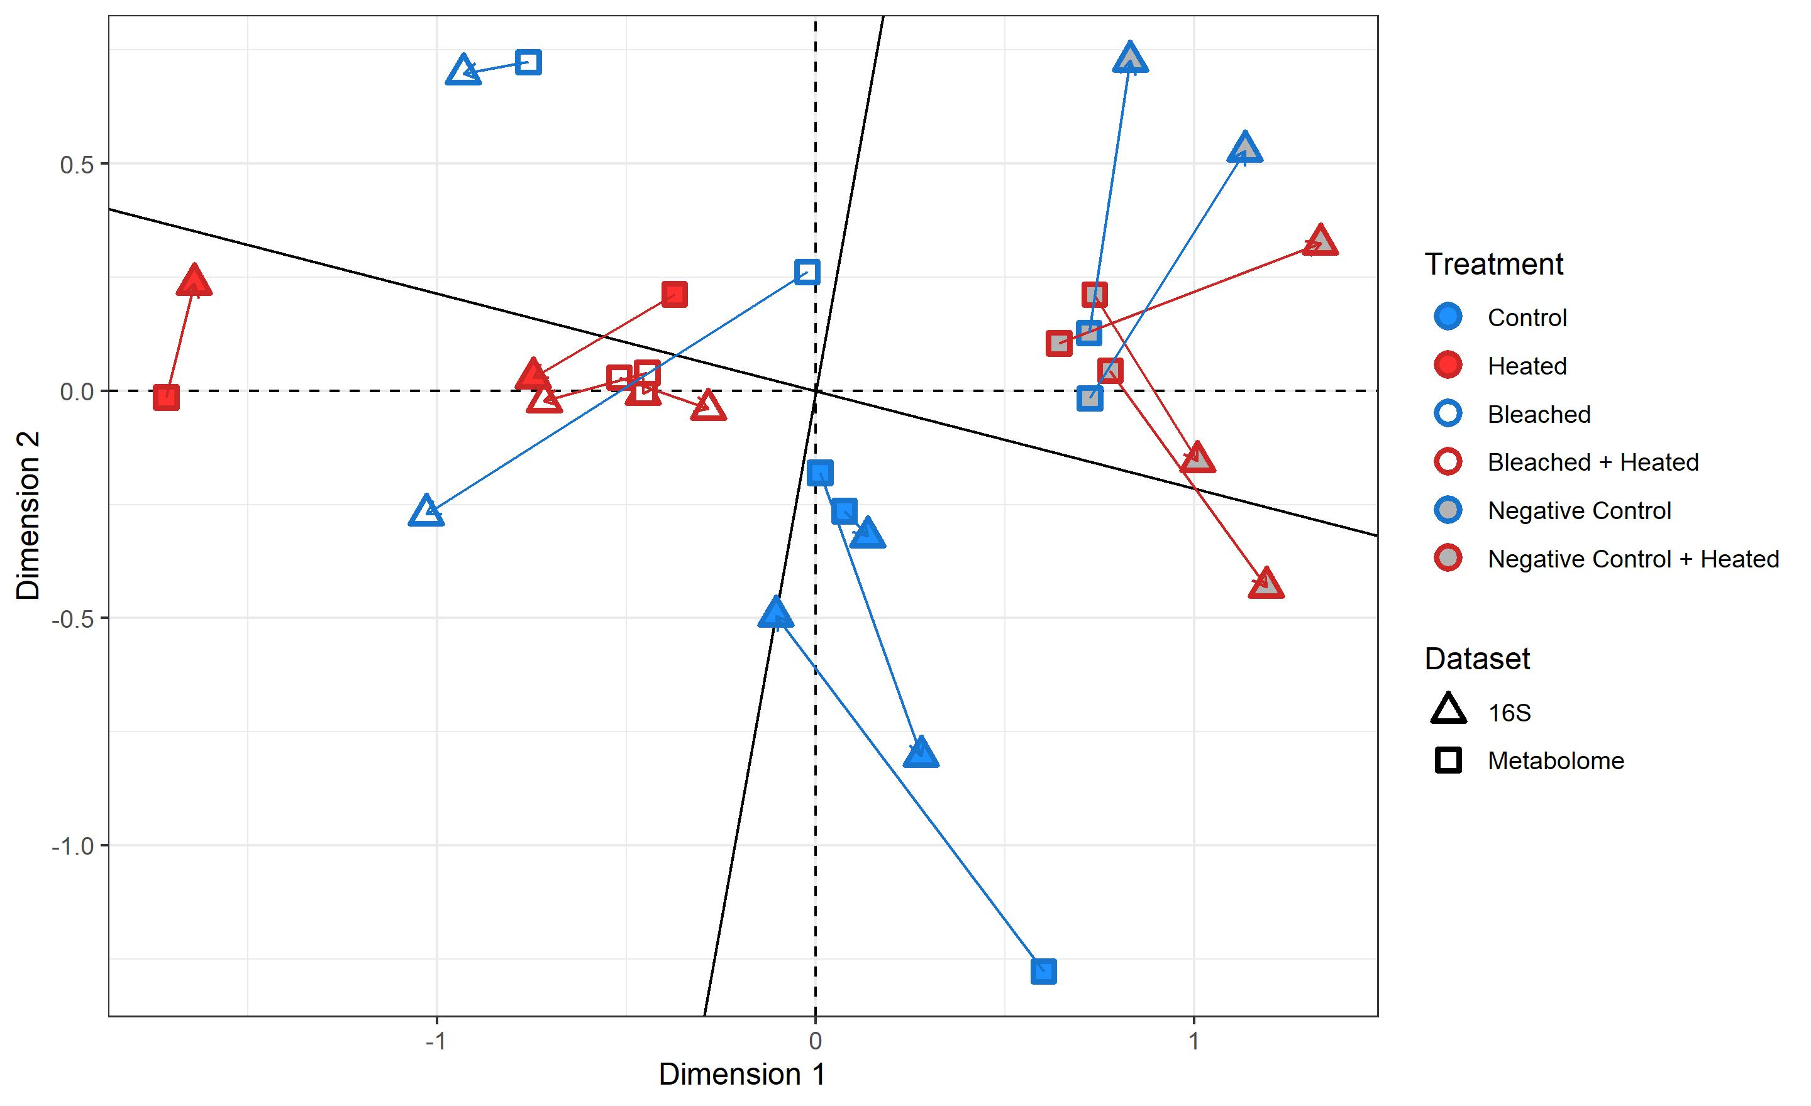
A
A
B
B
Figure 4: Exometabolome composition A) Non-metric multidimensional scaling plot of t0 metabolomic samples using bray curtis dissimilarity. A dashed ellipse denotes the 3 coral stress treatments while a solid ellipse denotes the ambient coral Control treatment. B) Procrustes visualization of multivariate metabolomic and microbial samples. Arrows point from microbial samples to corresponding metabolomic samples.

Slide 6
Figure 5: Conceptual representation of biogeochemical changes during a coral bleaching event. Bleaching progresses from left to right, with SST values increasing until their peak and then return to ambient values. Corals experience a change in physiological state and symbiont densities through the thermal anomaly, going from “Healthy” to “Thermal Stress Onset” to “Peak Bleaching” and lastly, “Recovering”. The associated treatment names from our experiment are written below the corals. Symbiont densities for each treatment are plotted with temperature, with densities decreasing through “Peak Bleaching” and then increasing slightly in “Recovering.” Densities were derived from data presented in Figure 1D. DOM flux is highest at “Thermal Stress Onset”, indicated by the size of the arrows pointing from corals to “DOM”. In all 3 of the stressed treatments, bacterioplankton communities shift towards a “microbialized” state marked by increased cell counts (indicated by the size of the arrow pointing towards the pie chart) and a greater relative abundance of copiotrophs and pathogens, namely in the Alteromonadaceae, Pseudoalteromonadaceae, and Flavobacteriaceae families. We propose that these microbialized communities derived from stressed coral DOM exudates further harm the corals via hypoxia from increased bacterial loads and disease from the uptick in bacterial pathogens. The state of microbialization is most pronounced at the onset of thermal stress, may push corals towards more severe bleaching and ultimately, mortality.

Slide 7
Supplemental figures

Slide 8
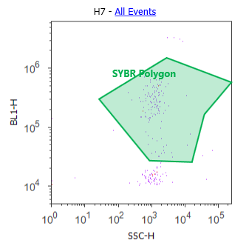
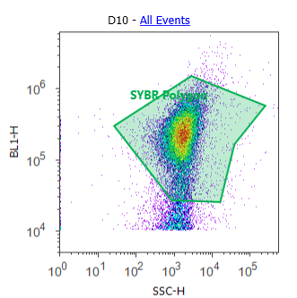
Control
Sample
Figure S1: Representative density plots of gated SYBR polygon derived bacterial counts for a SYBR stained .2µm filtered milliq control and a SYBR stained sample.

Slide 9
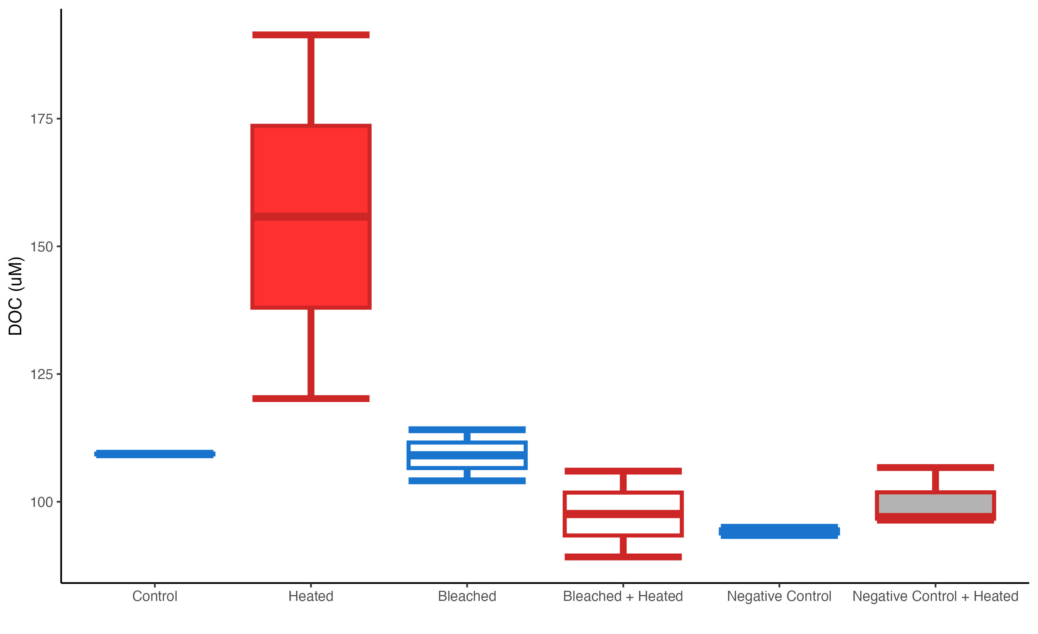
S1
Figure S2: Box and whisker plots of raw DOC exudate concentrations (µM) for the 6 treatments.

Slide 10
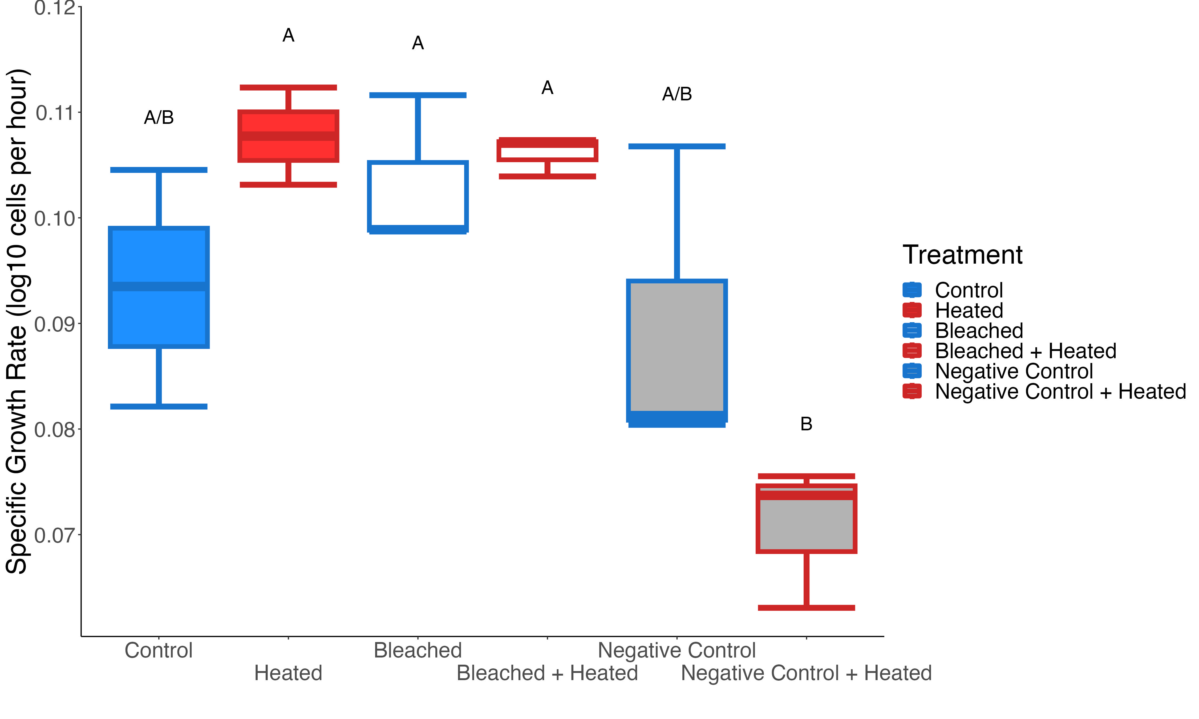
Figure S3: Box and whisker plots of bacterial specific growth rate, in log10 cells per hour, for the 6 treatments. Significant differences between treatments (Tukey post-hoc test, p<0.05) are denoted by letters above each boxplot.

Slide 11
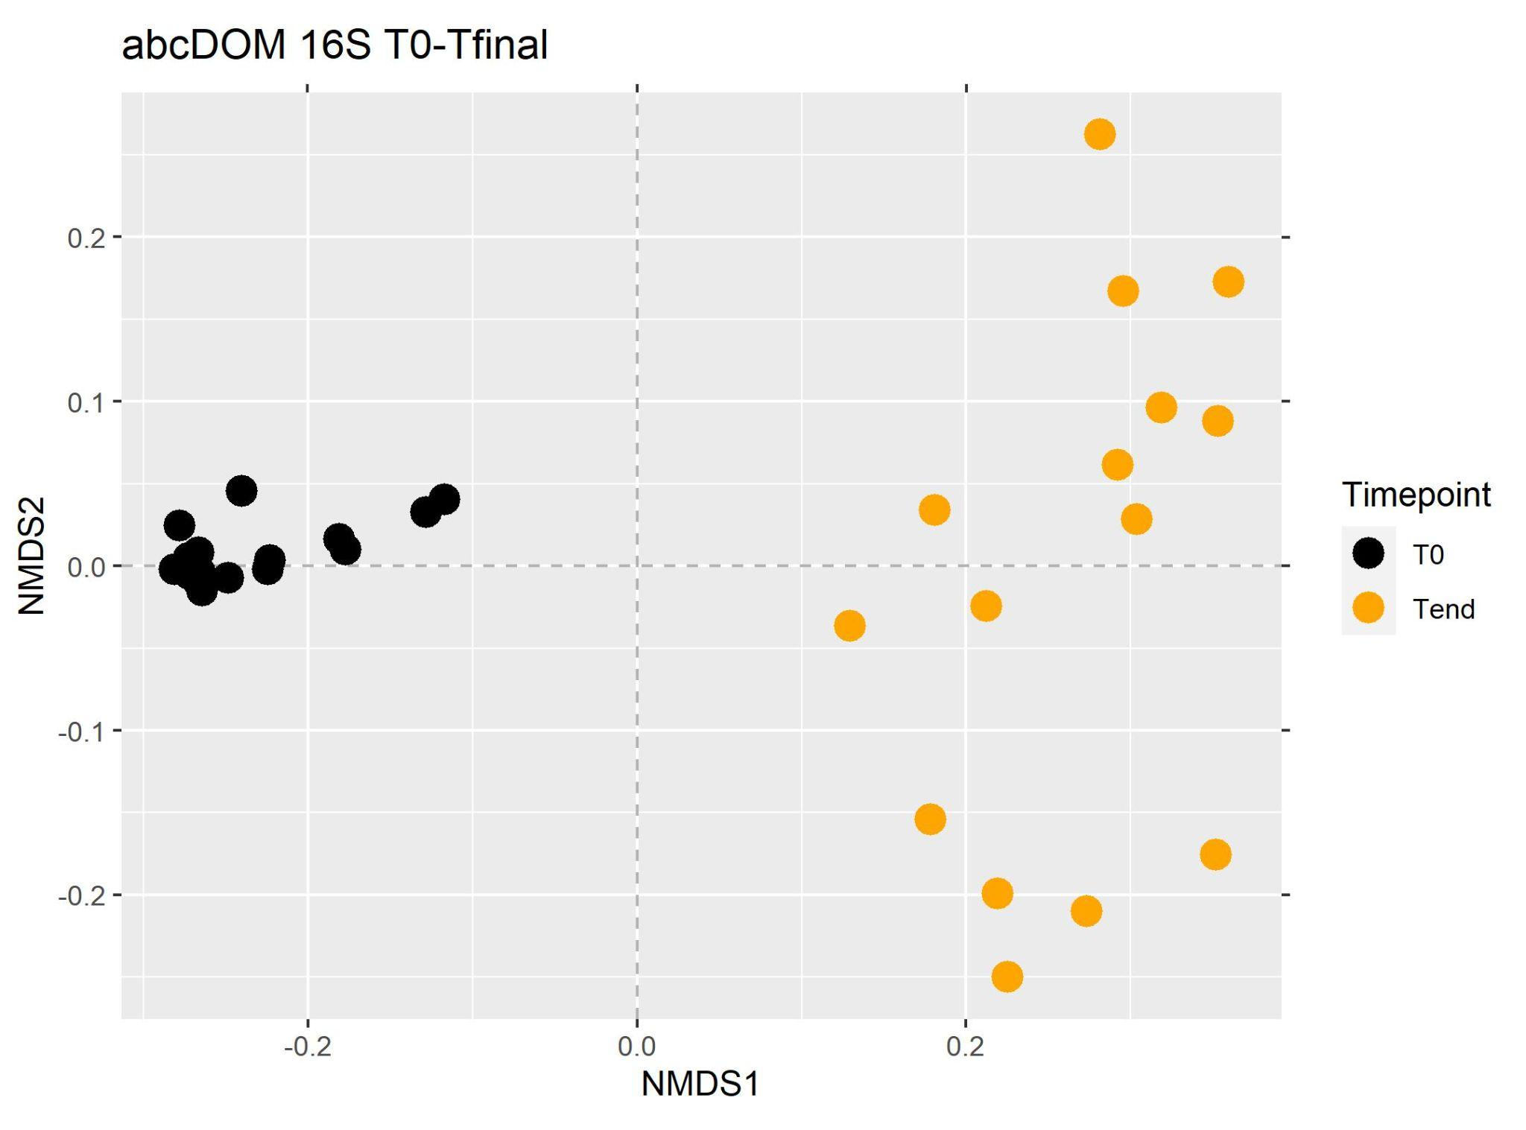
Figure S4: Non-metric multidimensional scaling plot of bacterial communities from start and end of bottle incubation using unifrac dissimilarity.

Slide 12
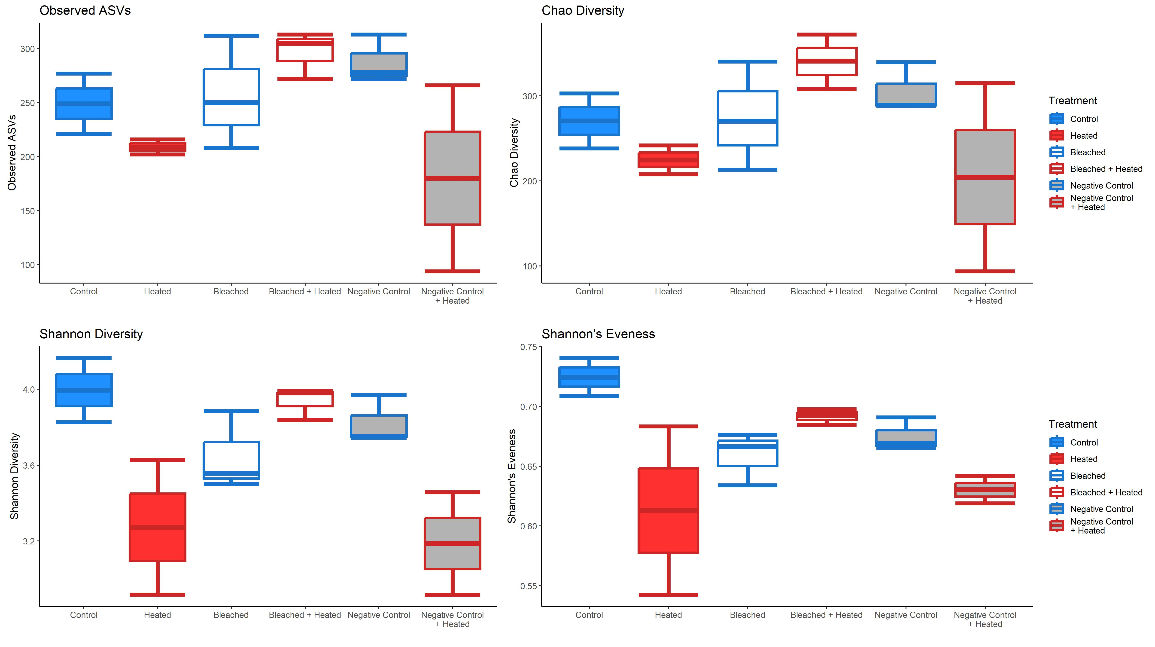
Figure S5: Box and whisker plots of the alpha diversity of the bacterial communities at the end of the incubation

Slide 13
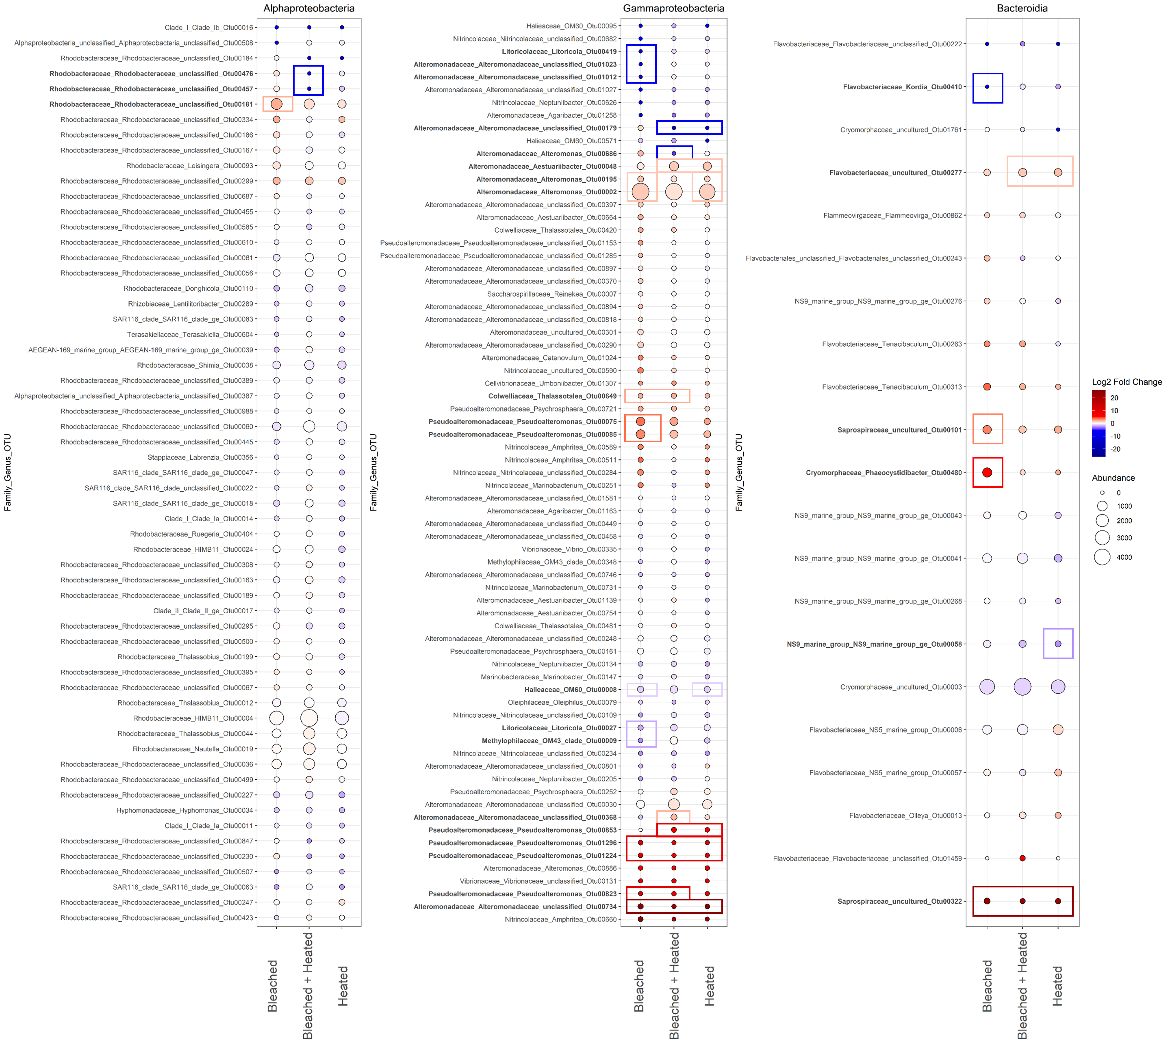
Figure S6: Direct comparison of bacterial OTUs enriched and/or depleted in the three stressed coral treatments relative to the Control corals. The log2 fold change of the 159 most abundant/prevalent OTUs in the three coral stress treatments compared to the Control treatment. Points are colored by log2 fold change, with warmer colors indicating more enrichment and cooler colors indicating more depletion relative to the Controls. Point size indicates the mean abundance of a given OTU in a given treatment. OTUs are labeled according to their family, genus, and OTU Number on the y axis. OTUs labeled in bold were determined by DESEq2 to be significantly differentially abundant in at least one of the three treatments compared to Controls (p≤.05 after FDR). Boxes denote in which treatment there is a significant change and the color of the box indicates whether this was a significant enrichment (red) or depletion (blue).

Slide 14
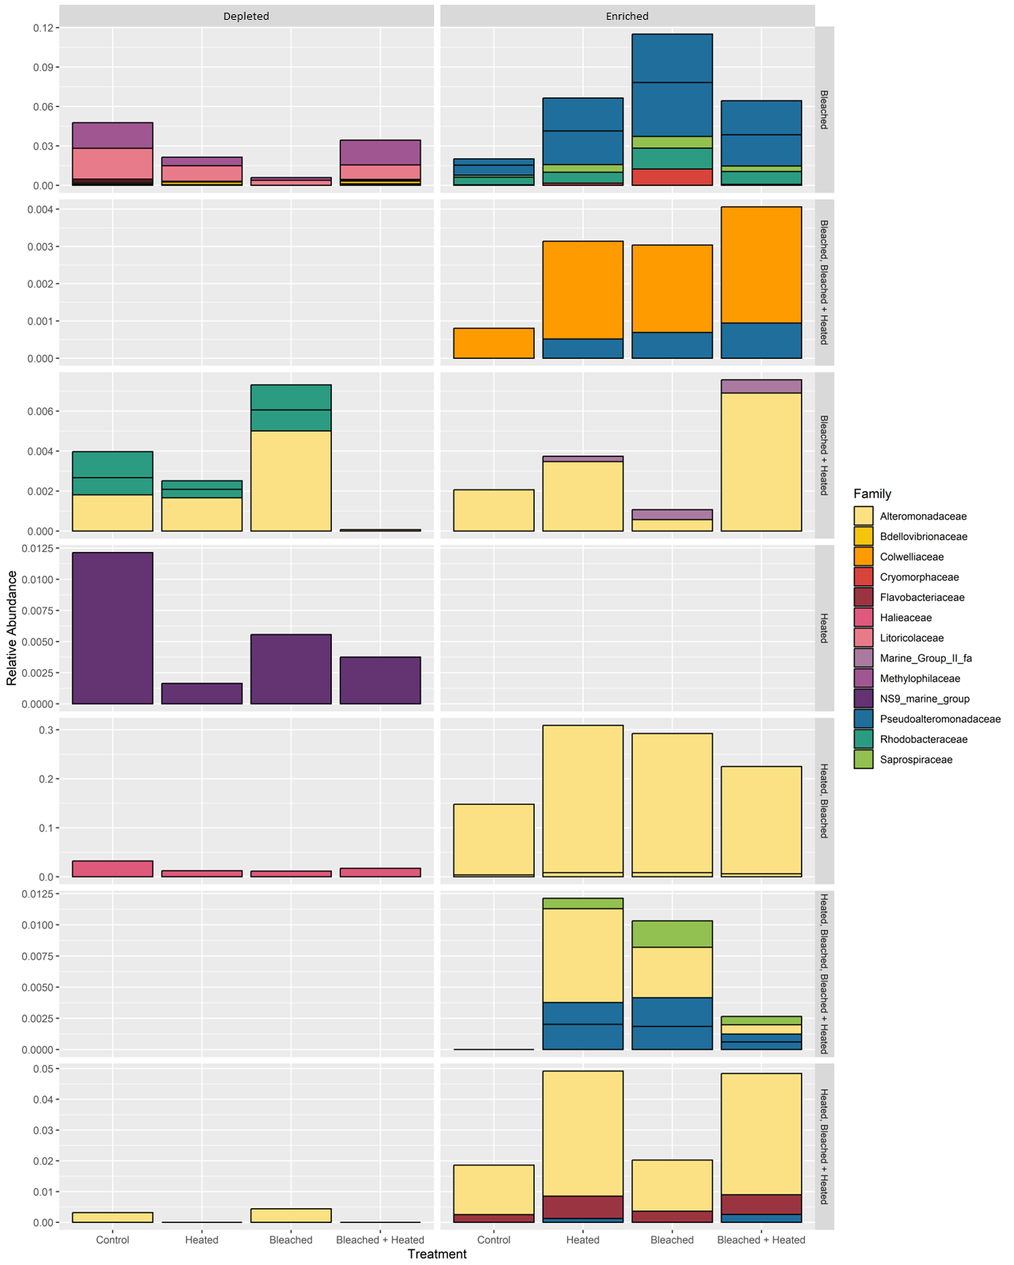
Figure S7: Stacked barplots of the relative abundance of significant OTUs (p≤.05 after FDR) enriched or depleted in any of the 3 coral stress treatments relative to the Control treatment according to DESEq2. Column facets denote if a given OTU is enriched or depleted relative to the Control. Row facets denote which treatments a group of OTUs is either significantly enriched or depleted in. Relative abundance was derived from the non-subsampled, raw abundance data used in DESEq2. Bars are colored according to bacterial Family.

